Slide 1

Resume builder

Slide 2
Team
Madhur Maheshwari(Team Leader)
Sakshi Panwar(Team Member)
Nistha Goyal(Team Member)
Supervisor
Mr. Prashant Agrawal

Slide 3
Introduction
An online resume builder is a software developed to simplify the task of creating a resume for individuals. The application provides an effective means of designing desired resume in fact a professional looking resume. The system is flexible to be used and reduces the need of thinking and designing an appropriate resume according to qualifications. Usually, individuals get confused while creating a resume especially for a novice person such as graduate students. They don’t get a clear idea of what things and information must be included in a resume. Hence the system is developed to provide them an easy way for creating a professional looking resume.

Slide 4
Technologies
Front End
Web technology :- JavaScript
Languages used :- JavaScript, HTML, CSS
Development tool :- Sublime text
Back End
Database :- MongoDB
Operating System
Window 10
Any Operating system compatible with WWW

Slide 5
Module
User Login :- Users must create an account into the system by registering themselves. Then they may login into the system and can utilize services.
Resume Templates :- The system contains various kinds of resume templates for all kind of qualification i.e. for both fresher and experienced. And, according to the kind of degree one has.

Slide 6
Resume form:- Users on selecting the format will be given an online form to be filled. The form includes questions like academics, personal, interests, hobbies, skills, courses, experience and so on.
Export facility: Users can even export the PDF

Slide 7
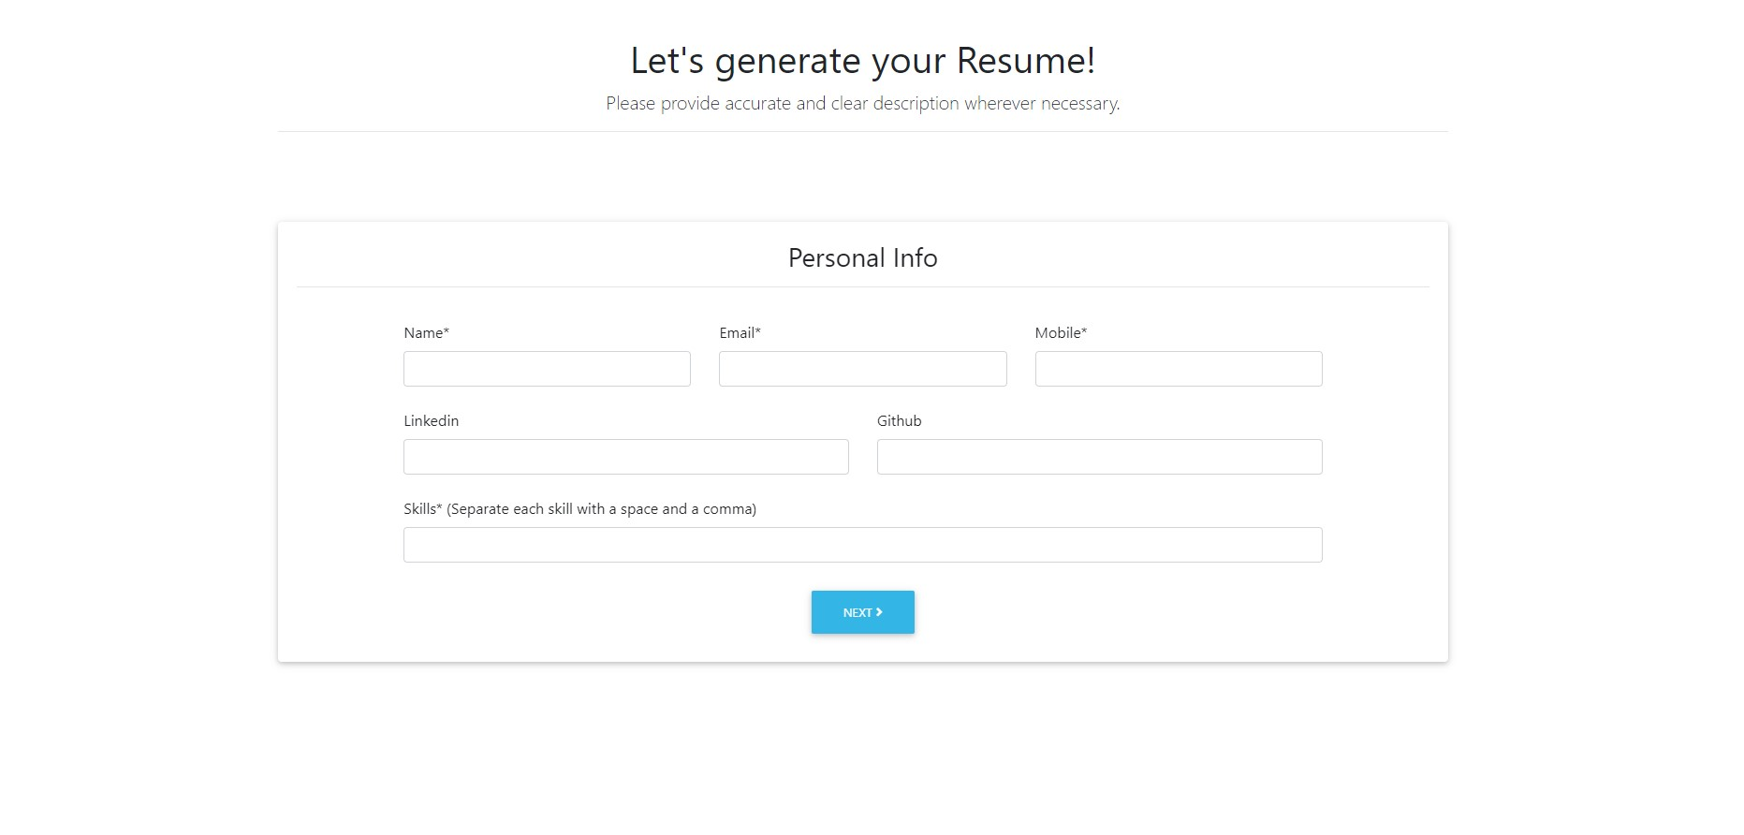
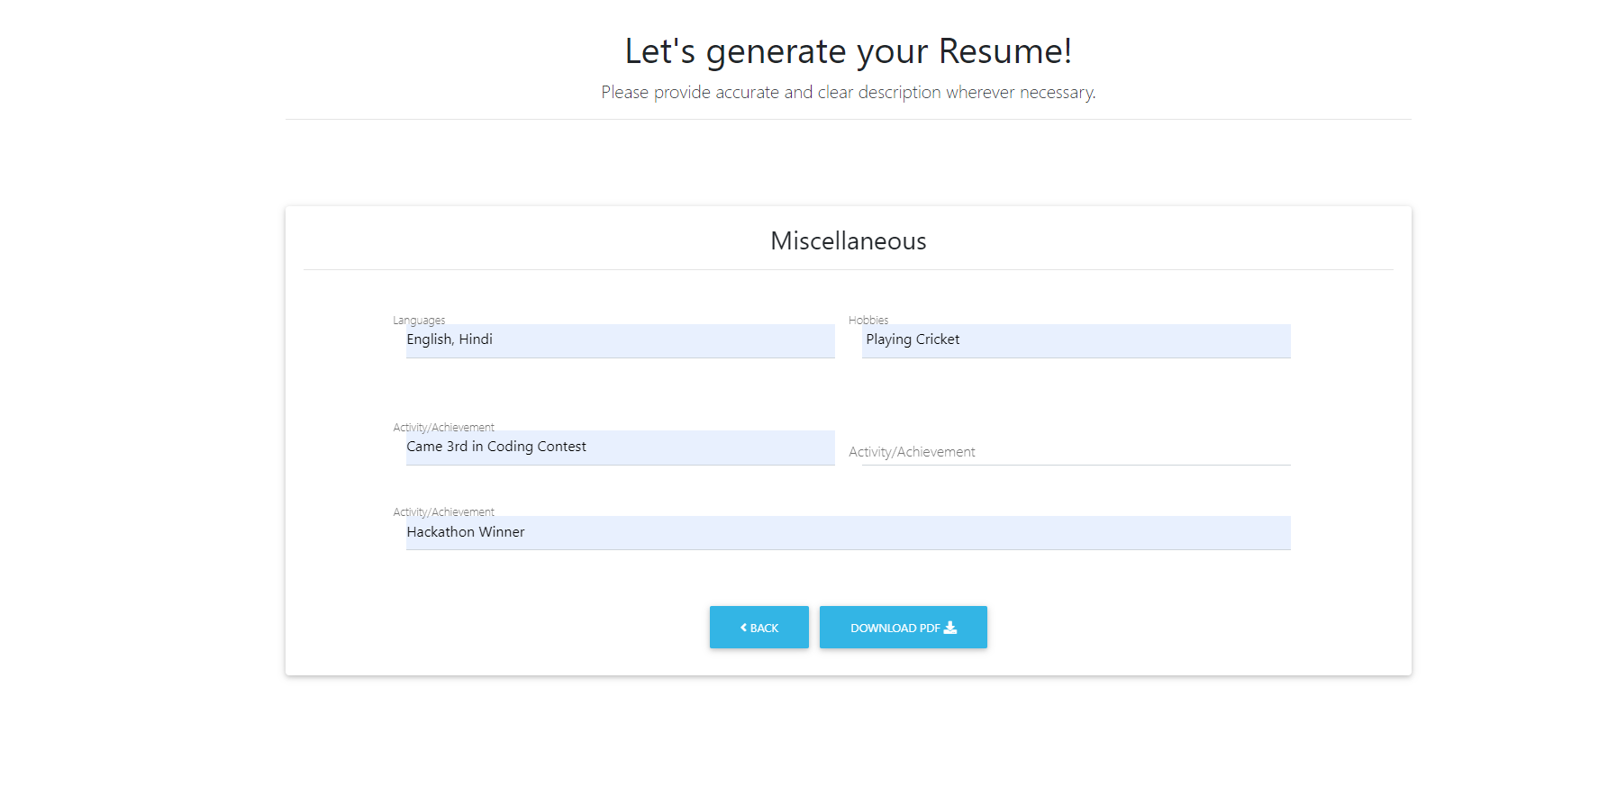
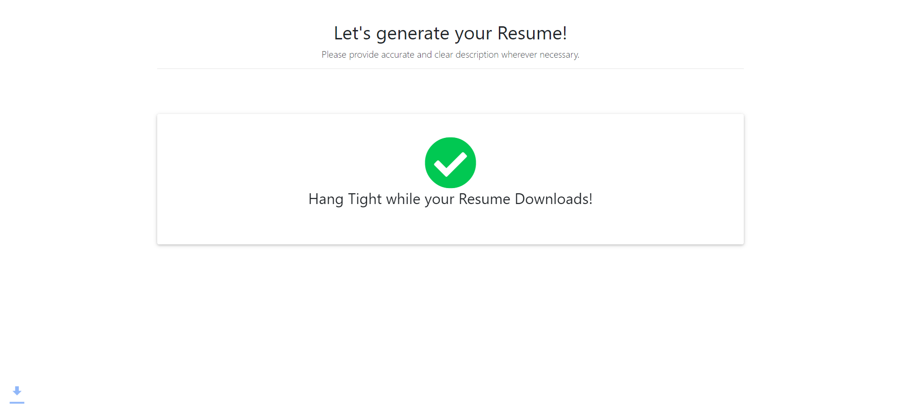
Main Form

Slide 8
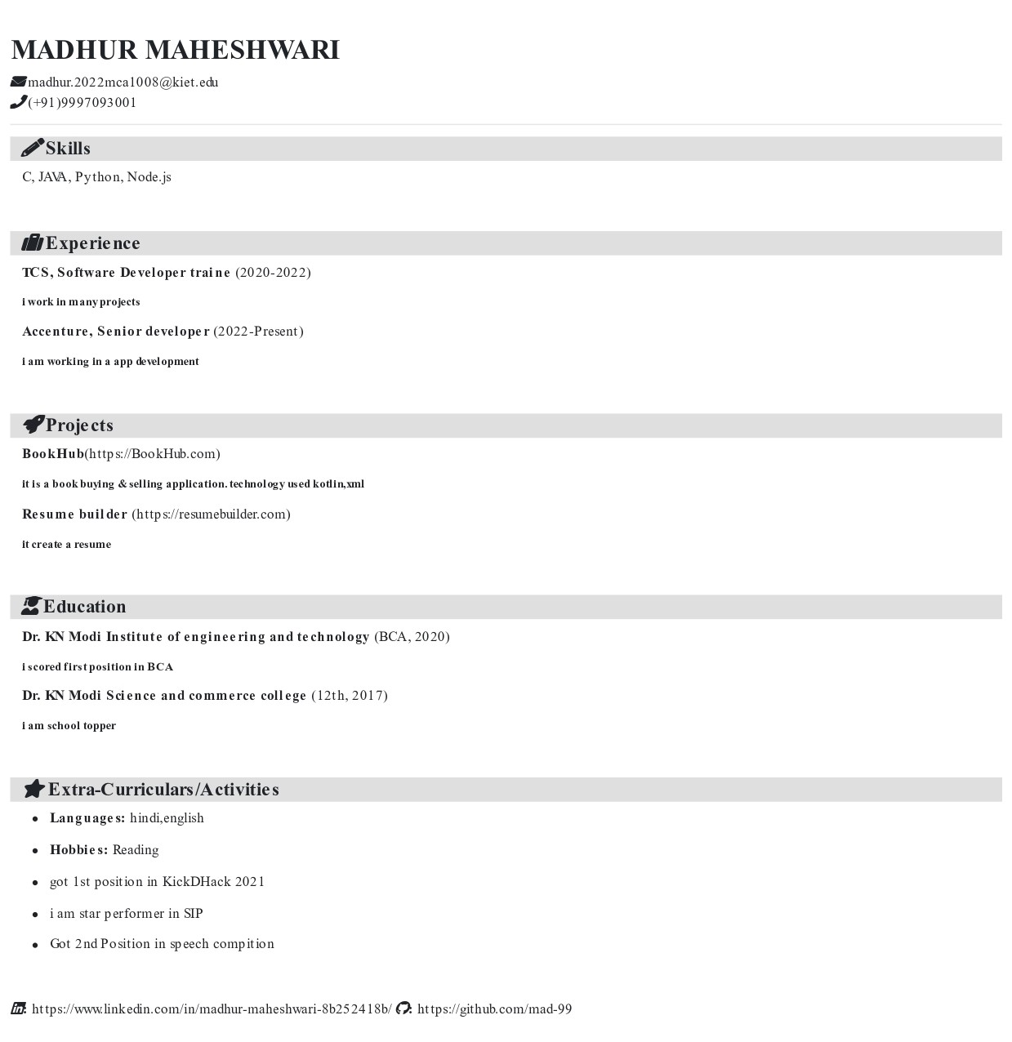
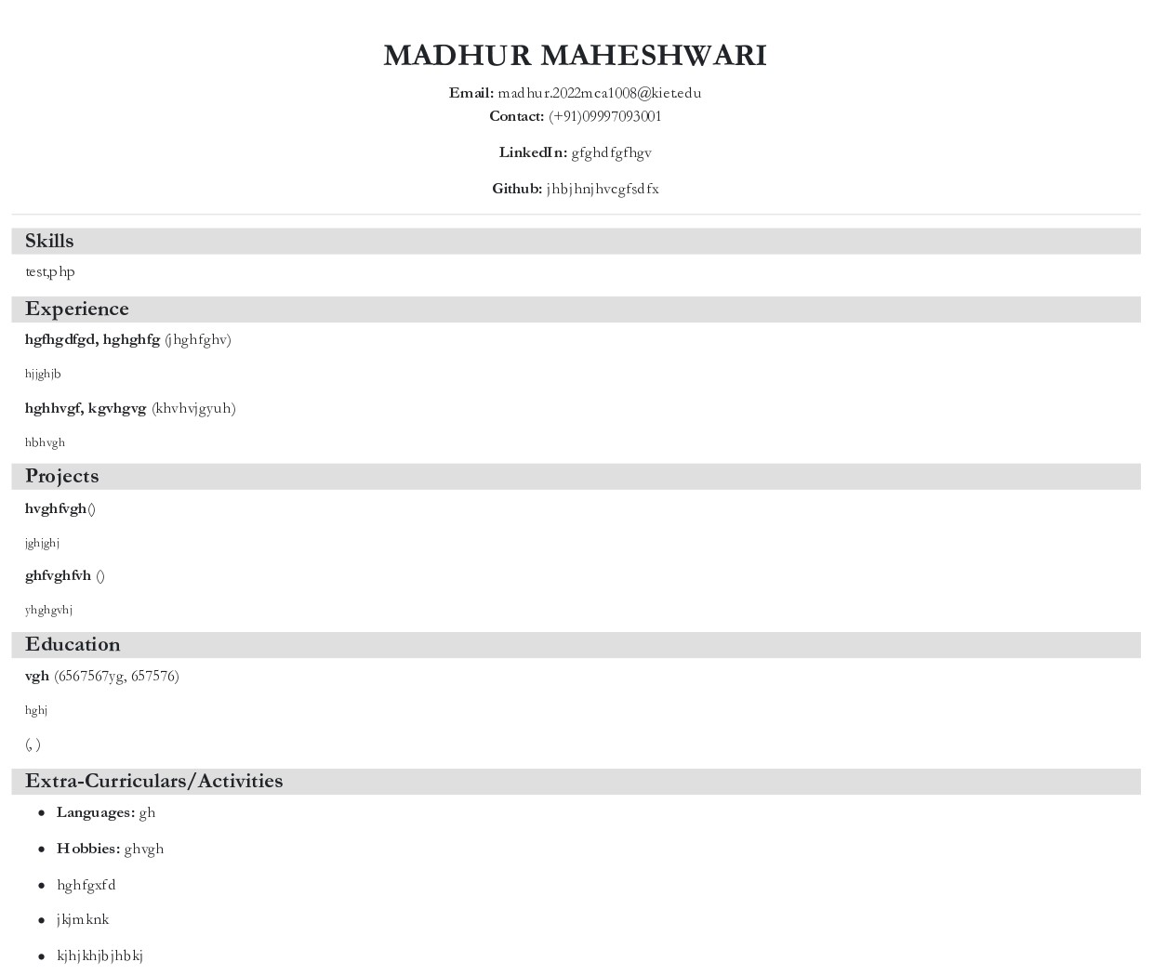
Output

Slide 9
Conclusion
The online resume builder is one of the most fantastic systems for the people who are either freshers in their domain or if they don’t have enough idea about the resume or don’t have enough time to create the resume of good designs or patterns, then this platform is a very productive place for them. It saves a lot of time and cost-effective.

Slide 10
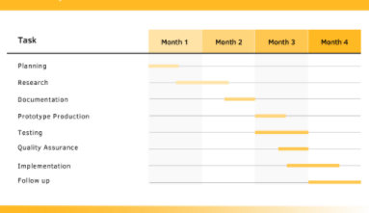
Gantt chart

Slide 11
Thankyou

